Slide 1
Algorithms for learning in simple and complex games
Viliam Lisý
Artificial Intelligence Center
Department of Computer Science, Faculty of Electrical Engineering
Czech Technical University in Prague
(Sep 24, 2018)

Slide 2
Algorithms for learning in simple and complex games Brief Introduction to Game Theory
Viliam Lisý
Artificial Intelligence Center
Department of Computer Science, Faculty of Electrical Engineering
Czech Technical University in Prague
(Sep 24, 2018)

Slide 3
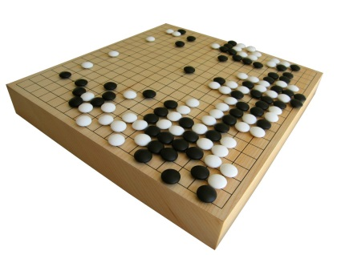
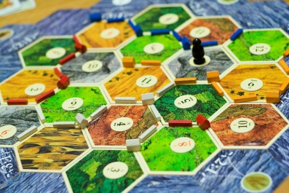
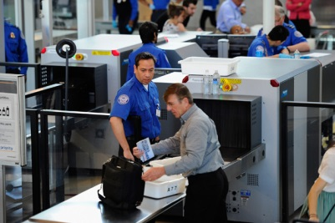
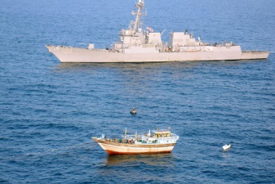
Game Theory
Mathematical framework studying strategies of players in situations where the outcomes of their actions critically depend on the actions performed by the other players.

Slide 4
Computational Game Theory
Analytic approach
Computational approach
Small model size
Inputs in analytic form
Analysis of system behavior
Complete understanding
Huge model size
Real world data as inputs
Computing optimal strategies
Partial understanding

Slide 5
Matrix (normal form) games
Player 2
Column player
Minimizer
 | r | p | s
R | 0 | -1 | 1
P | 1 | 0 | -1
S | -1 | 1 | 0
Player 1
Row player
Maximizer
Zero-sum game, pure strategy, mixed strategy
Best response
Nash equilibrium, game value
$$BR_{i}\left(σ_{−i}\right)=\arg{\max_{a_{i}∈A_{i}}{U_{i}\left(a_{i}, σ_{−i}\right)}}$$

Slide 6
Non-zero Sum Games
What is the Nash equilibrium?
Equilibrium selection problem
Correlated equilibria, coarse correlated
Stackelberg equilibrium
 | b | f
B | 2, 1 | 0, 0
F | 0, 0 | 1, 2
 | c | d
C | -1, -1 | -7, 0
D | 0, -7 | -5, -5

Slide 7
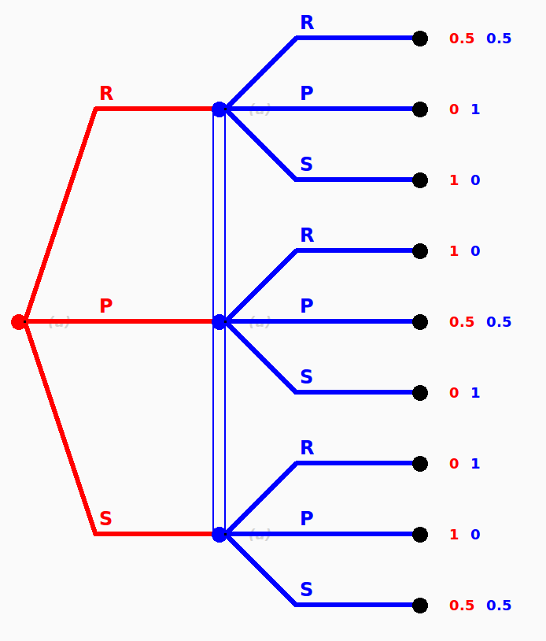
Extensive-form game

Slide 8
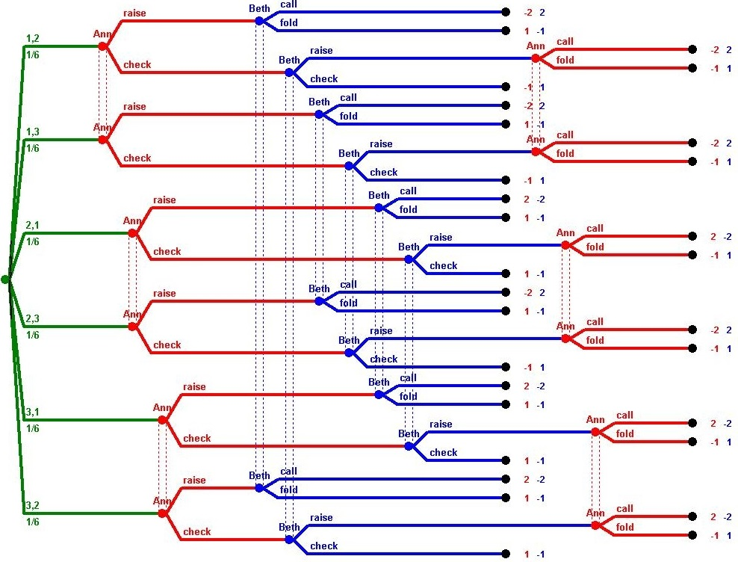
Extensive Form Games

Slide 9
Plan
Online learning and prediction
single agent learns to select the best action
Learning in normal form games
the same algorithms used by multiple agents
Learning in extensive form games
generalizing these ideas to sequential games
Brief introduction to neural networks
DeepStack

Slide 10
Algorithms for learning in simple and complex games Introduction to Online Learning and Prediction
Viliam Lisý
Artificial Intelligence Center
Department of Computer Science, Faculty of Electrical Engineering
Czech Technical University in Prague
(Sep 24, 2018)

Slide 11
Introduction
Online learning and prediction
learning from data that become available in sequence
adapting prediction (behavior) after each data point
optimizing overall precision (not only after all data arrive)
Applications
investing in best fond
web advertisements
selecting the best (e.g., page replacement) algorithm

Slide 12
Introduction
Why do we care about online learning in games?
repeated play against an unknown opponent
(repeated) play of an unknown game
understanding how equilibria may occur in real world
computationally efficient equilibrum approximation algorithms

Slide 13
Prediction with expert advice
 | $$σ^{0}$$ | $$u^{0}$$ | $$σ^{1}$$ | $$u^{1}$$ | $$σ^{2}$$ | $$u^{2}$$ | … | $$σ^{T}$$ | $$u^{T}$$
$$a_{1}$$ | 0.2 | 0 | 0.1 | 1 | 0.3 | 0
$$a_{2}$$ | 0.5 | 0.5 | 0.4 | 0.5 | 0.3 | 1
$$a_{3}$$ | 0.3 | 1 | 0.5 | 0 | 0.4 | 0
$$σ^{t}⋅u^{t}$$ | $$x^{0}=0.55$$ |  | $$x^{1}=0.3$$ |  | $$x^{2}=0.3$$ |  |  | $$x^{T}$$
Problem definition
Set of $n$ actions (experts) $A=\{a_{1}, a_{2}, …,a_{n}\}$
Set of time steps $t=\left\{1,2,…, T\right\}$
In each step
Decision-maker selects a mixed strategy $σ^{t}$
An adversary selects rewards $u^{t}:A→[0,1]$ (adaptive vs oblivious)
Action $a^{t}∈A$ is selected based on $σ^{t}$
The decision-maker receives reward $u^{t}(a^{t})$ (learns the whole $u^{t})$

Slide 14
External Regret
 | $$σ^{0}$$ | $$u^{0}$$ | $$σ^{1}$$ | $$u^{1}$$ | $$σ^{2}$$ | $$u^{2}$$ | … | $$σ^{T}$$ | $$u^{T}$$
$$a_{1}$$ | 0.2 | 0 | 0.1 | 1 | 0.3 | 0
$$a_{2}$$ | 0.5 | 0.5 | 0.4 | 0.5 | 0.3 | 1
$$a_{3}$$ | 0.3 | 1 | 0.5 | 0 | 0.4 | 0
$$σ^{t}⋅u^{t}$$ | $$x^{0}=0.55$$ |  | $$x^{1}=0.3$$ |  | $$x^{2}=0.3$$ |  |  | $$x^{T}$$
Goal: play as well as the best expert
Immediate regret at time $t$ for not choosing action $i$
$r^{t}\left(i\right)=u^{t}\left(i\right)−x^{t}$
Cumulative external regret for playing $σ^{0},σ^{1}…σ^{T}$
$R^{T}=max_{i∈A}\sum_{t=0}^{T}{r^{t}(i)}=max_{i∈A}\sum_{t=0}^{T}{u^{t}(i)}−\sum_{t=0}^{T}{x^{t} }$
Average external regret for playing $σ^{0},σ^{1}…σ^{T}$
${\overline{r}}^{T}=\frac{1}{T}R^{T}$

Slide 15
Swap Regret
 | $$σ^{0}$$ | $$u^{0}$$ | $$σ^{1}$$ | $$u^{1}$$ | $$σ^{2}$$ | $$u^{2}$$ | … | $$σ^{T}$$ | $$u^{T}$$
$$a_{1}$$ | 0.2 | 0 | 0.1 | 1 | 0.3 | 0
$$a_{2}$$ | 0.5 | 0.5 | 0.4 | 0.5 | 0.3 | 1
$$a_{3}$$ | 0.3 | 1 | 0.5 | 0 | 0.4 | 0
$$σ^{t}⋅u^{t}$$ | $$x^{0}=0.55$$ |  | $$x^{1}=0.3$$ |  | $$x^{2}=0.3$$ |  |  | $$x^{T}$$
Goal: minimize regret for not playing a $δ\left(a\right)$instead of $a$ for some $δ:A→A$
Cumulative swap regret for playing $σ^{0},σ^{1}…σ^{T}$
$R^{T}=max_{δ}\sum_{t=0}^{T}{\sum_{i∈A}{{σ^{t}\left(i\right)(u}^{t}\left(δ(i)\right)−u^{t}(i))} }$
Internal regret
allows switching only all occurrences of $a_{i}$ by $a_{j}$
External $⊂$ Swap, Internal $⊂$ Swap

Slide 16
No-regret algorithms
An algorithm has no regret if for any $u^{0},u^{1}…u^{T}$produces $σ^{0},σ^{1}…σ^{T}$ such that ${\overline{r}}^{T}→0$ as $T →∞$.

Slide 17
Why not simply to maximize reward?
$$maximize\sum_{t=0}^{T}{x^{t}}$$
The adversary may choose ${∀i∈A , u}^{t}\left(i\right)=0$ and we have minimal reward regardless of the used algorithm.
Any algorithm has (optimal) 0 regret.

Slide 18
Regret towards best strategy in hindsight
$${R_{best}}^{T}=\sum_{t=0}^{T}{{max_{i∈A }u}^{t}(i)}− \sum_{t=0}^{T}{x^{t}}$$
Proposition: There is no algorithm with no regret towards the best sequence of choices.
Proof: Let $A=\{U,D\}$. For an arbitrary sequence of strategies $σ^{t}$, choose a reward vector $u^{t}=\left(0,1\right)$ if $σ^{t}\left(U\right)≥\frac{1}{2}$ and $u^{t}=\left(1,0\right)$ otherwise.
The cumulative reward of the algorithm $\sum_{t=0}^{T}{x^{t}}≤\frac{T}{2}$, while the best strategy in hindsight has reward $\sum_{t=0}^{T}{{max_{i∈A }u}^{t}(i)}=T$. Therefore
${R_{best}}^{T}≥\frac{T}{2}$ and ${\overline{r}}_{best}^{T}→z≥\frac{1}{2}$

Slide 19
Regret of deterministic algorithms
Proposition: There is no deterministic no-external-regret algorithm.
Proof: We assume that the adversary selects rewards $u^{t}$ knowing strategy $σ^{t}.$ (For example, it can simulate the deterministic algorithm from the beginning.) Therefore, with $n=2$, he can always give reward 0 for the selected action and 1 for the other action. One of the actions got reward 1 at least $T/2$ times, therefore ${\overline{r}}^{t}≥\frac{1}{2}$.

Slide 20
Lower bound on external regret
Theorem:No (randomized) algorithm over $n$ actions has expected external regret vanishing faster than$Θ(\sqrt{ln⁡(n)/T})$.
Proof sketch: Assume n=2. Consider an adversary that, independently on each step t, chooses uniformly at random between the cost vectors (1, 0) and (0, 1) regardless of the decision-making algorithm. The cumulative expected reward is exactly $T/2$. In hindsight, however, with constant probability one of the two fixed actions has cumulative reward $T/2+Θ(\sqrt{T})$. The reason is that T fair coin flips have standard deviation $Θ(\sqrt{T}$).

Slide 21
Lower bound on external regret
Theorem: There exist no-regret algorithms with expected external regret $O(\sqrt{\ln\left(n\right)/T}$).
Proof: We will show Randomized Weighted Majority algorithm.
Corollary: There exists a decision-making algorithm that, for every $ε>0,$ has expected regret less than $ε$ after $O(\ln\left(n\right)/ε^{2})$ iterations.

Slide 22
Randomized Weighted Majority
Aka Hedge or multiplicative weights (MW) algorithm. It is easier to analyze in costs $c\left(i\right)=(1−u\left(i\right))$. The algorithm maintains weights $w(i)$ for each action $i∈A$.
Initialize $w^{1}\left(i\right)=1$ for every $i∈A$
For each time $t=1,2,…, T$
Let $W^{t}=\sum_{i∈A}{w^{t}(i)}$ and play $σ^{t}(i)=w^{t}(i)/W^{t}$
Given costs $c^{t}$, set $w^{t+1}\left(i\right)=w^{t}\left(i\right){\left(1−γ\right)}^{c^{t}(i)}$ for each $i∈A$
(Equivalently $w^{t+1}\left(i\right)=w^{t}\left(i\right)e^{{−ηc}^{t}(i)}$ for $η=−ln⁡(1−γ$) )

Slide 23
Hedge Regret Bound
Theorem: Expected external regret of Hedge is ${\overline{r}}^{T}<2\sqrt{ln(n)/T}$
Proof: W.L.O.G. we assume oblivious adversary.
Let $OPT=\min_{i∈A}{\sum_{t=1}^{T}{c^{t}(i)}}$ be the cost for optimal action $i^{∗}$ and
$ν^{t}=\sum_{i∈A}{σ^{t}\left(i\right)c^{t}\left(i\right)=}\sum_{i∈A}{\frac{w^{t}\left(i\right)}{W^{t}} c^{t}\left(i\right)}$ be the algorithms cost at $t$.
$W^{T}≥w^{T}\left(i^{∗}\right)=w^{1}\left(i^{∗}\right)\prod_{t=1}^{T}{{\left(1−γ\right)}^{c^{t}\left(i^{∗}\right)}}={\left(1−γ\right)}^{OPT}$
$W^{t+1}=\sum_{i∈A}{w^{t+1}\left(i\right)=}\sum_{i∈A}{w^{t}\left(i\right){\left(1−γ\right)}^{c^{t}(i)}}$
$≤\sum_{i∈A}{w^{t}\left(i\right)\left(1−γc^{t}\left(i\right)\right)}=W^{t}(1−γν^{t})$
${\left(1−γ\right)}^{OPT}≤W^{T}≤W^{1}\prod_{t=1}^{T}{\left(1−γν^{t}\right)}$
$OPT\ln\left(1−γ\right)≤ \ln{n}+\sum_{t=1}^{T}{ln⁡(1−γν^{t})}$
… $\sum_{t}^{T}{ν^{t}}≤OPT+γT+\frac{\ln{n}}{γ}$ => $\frac{1}{T}\sum_{t}^{T}{ν^{t}}≤\frac{OPT}{T}+2\sqrt{\frac{\ln{n}}{T}}$

Slide 24
Regret Matching
The algorithm maintains cummulative regrets $R(i)$ for each action $i∈A$.
Initialize $R^{1}\left(i\right)=0$ for every $i∈A$
For each time $t=1,2,…, T$
Let $S^{t}=\sum_{i∈A}{{\max{(0,}R}^{t}(i))}$ and play $σ^{t}(i)={\max{(0,}R}^{t}(i))/S^{t}$
Given rewards $u^{t}$, for each $i∈A$set
$$R^{t+1}\left(i\right)=R^{t}\left(i\right)+r^{t}(i)=R^{t}\left(i\right)+(u^{t}\left(i\right)−\sum_{j∈A}{σ^{t}\left(j\right)u^{t}(j))}$$

Slide 25
Regret Matching+
The algorithm maintains cumulative regrets-like values $Q(i)$ for each action $i∈A$.
Initialize $Q^{1}\left(i\right)=0$ for every $i∈A$
For each time $t=1,2,…, T$
Play $σ^{t}(i)=Q^{t}(i)/\sum_{j∈A}{Q^{t}(j)}$
Given rewards $u^{t}$, for each $i∈A$set
$$Q^{t+1}\left(i\right)=\max{(0,Q^{t}\left(i\right)+r^{t}\left(i\right))}=\max{(0,} u^{t}\left(i\right)−\sum_{j∈A}{σ^{t}\left(j\right)u^{t}(j))}$$

Slide 26
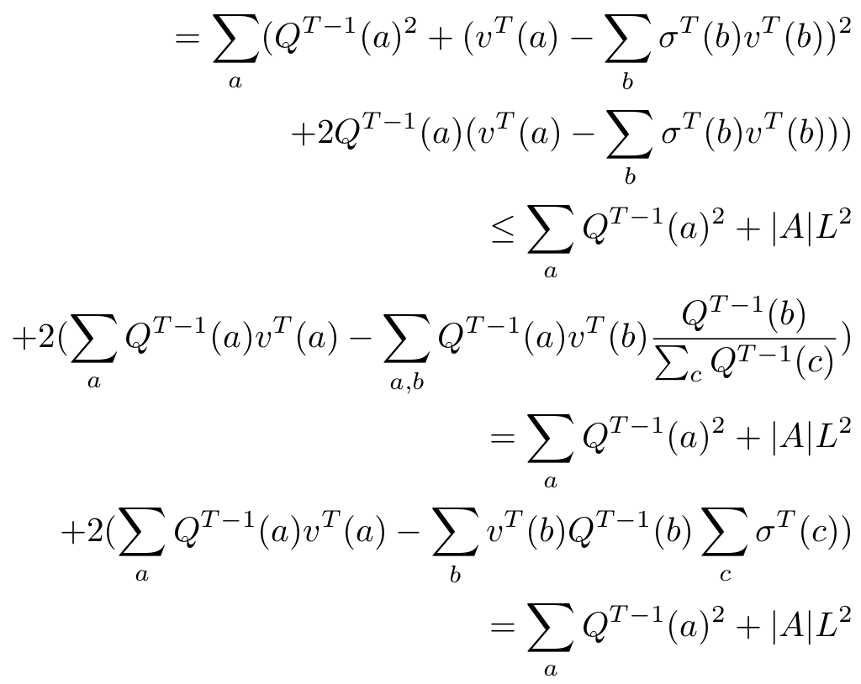
RM+ Regret Bound
Lemma: Regret-like values $Q^{t}\left(i\right)$ are an upper bound on $R^{t}\left(i\right).$
Proof: $Q^{t+1}\left(i\right)−Q^{t}\left(i\right)=\max\left(0,Q^{t}\left(i\right)+r^{t}\left(i\right)\right)−Q^{t}\left(i\right)$
$$≥Q^{t}\left(i\right)+r^{t}\left(i\right)−Q^{t}\left(i\right)=r^{t}(i)$$
Lemma: For any $i$and value functions $Q^{T}\left(i\right)≤\sqrt{nT}$.
Proof: ${\left(\max_{i∈A }{Q^{T}\left(i\right)}\right)}^{2}=\max_{i∈A }{Q^{T}{\left(i\right)}^{2}}≤\sum_{i∈A}{Q^{T}{\left(i\right)}^{2}}=$
$=\sum_{i∈A}{\max{(0,Q^{T−1}\left(i\right)+u^{T}(i)}−\sum_{j∈A}{σ^{T}\left(j\right)u^{T}\left(j\right)})^{2}}$
… $≤\sum_{i}{Q^{T−1}{\left(i\right)}^{2}+n}$
By induction $Q^{T}{\left(i\right)}^{2}≤nT$.

Slide 27
Summary
General setting of prediction with expert advice
Regret as a measure of distance from the optimal strategy
There are no-regret algorithms
Hedge, Regret matching, Regret matching+

Slide 28
Plan
Online learning and prediction
single agent learns to select the best action
Learning in normal form games
the same algorithms used by multiple agents
Learning in extensive form games
generalizing these ideas to sequential games
Brief introduction to neural networks
DeepStack

Slide 29
Algorithms for learning in simple and complex games Learning in Normal Form Games
Viliam Lisý
Artificial Intelligence Center
Department of Computer Science, Faculty of Electrical Engineering
Czech Technical University in Prague
(Sep 24, 2018)

Slide 30
Introduction
How may simple learning agents achieve equilibrium outcomes?
Best Response Dynamics (Fictitious play)
best response to average empirical play
needs to know the game
No-Regret Dynamics
each player uses no-regret algorithm
may now only their own actions and received rewards

Slide 31
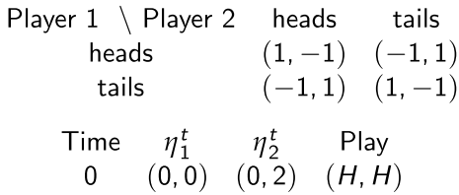
Best response dynamics
Fictitious play
Players maintain empirical distribution of past opponent’s actions
$${\overline{σ}}_{−i}^{T}=\frac{1}{T}\sum_{t=1}^{T}{σ_{−i}^{t}}$$
In each round, each player plays BR to these distributions
$$σ_{i}^{t}=\arg{\max_{a_{i}∈A_{i}}{U_{i}(a_{i},}}{\overline{σ}}_{−i}^{t})$$
(often in form of frequencies $η_{i}^{T}$)

Slide 32
Result of FP in case of convergence
Theorem: If the empirical action frequencies of fictitious play converge (${\overline{σ}}^{t} →σ^{∗})$ they converge to the Nash equilibrium of the game.
Theorem: The empirical frequencies of FP converge to NE in
constant-sum games
two player games where each player has up to two actions
games solvable by iterated strict dominance
identical interest games
potential games

Slide 33
Why it may not converge?
Shapley’s example in a modified rock-paper-scissors:
Unique NE is the uniform strategy for both players.
Let $η_{1}^{0}=(1,0,0)$ and $η_{2}^{0}=\left(0,1,0\right).$
Play may be (P,R),(P,R)… for $k$ steps until column switches to S.
Then (P,S) follows until row switches to R (for $βk$ steps, $β>1$).
Then (R,S) follows until column switches to P (for $β^{2}k$ steps).
The play cycles among all 6 non-diagonal profiles with periods of ever-increasing length, hence, the empirical frequencies cannot converge.
 | R | S | P
R | 0, 0 | 1, 0 | 0, 1
S | 0, 1 | 0, 0 | 1, 0
P | 1, 0 | 0, 1 | 0, 0

Slide 34
Convergence of FP
Theorem (Brandt, Fischer, Harrenstein, 2010): In symmetric two-player constant-sum games, FP may require exponentially many rounds (in the size of the representation of the game) before an equilibrium action is eventually played. This holds even for games solvable via iterated strict dominance.
Proof:
With $ε=2^{−k}$, FP may take $2^{k}$ rounds to play the equilibrium action $c$ for the first time.
(a,a),(b,b),…,(b,b)
 | a | b | c
a | 0 | -1 | -$ε$
b | 1 | 0 | -$ε$
c | $$ε$$ | $$ε$$ | 0
$2^{k}−1$ times

Slide 35
No-Regret Learning Summary
Immediate regret at time $t$ for not choosing action $i$
$r^{t}\left(i\right)=u^{t}\left(i\right)−σ^{t}{⋅u}^{t}$
Cumulative external regret for playing $σ^{0},σ^{1}…σ^{T}$
$R^{T}=max_{i∈A}\sum_{t=0}^{T}{r^{t}(i)}=max_{i∈A}\sum_{t=0}^{T}{u^{t}(i)}−\sum_{t=0}^{T}{σ^{t}{⋅u}^{t}}$
Average external regret for playing $σ^{0},σ^{1}…σ^{T}$
${\overline{r}}^{T}=\frac{1}{T}R^{T}$
An algorithm has no regret if for any $u^{0},u^{1}…u^{T}$produces $σ^{0},σ^{1}…σ^{T}$ such that ${\overline{r}}^{T}→0$ as $T →∞$.

Slide 36
From External to Swap Regret
Cumulative swap regret for playing $σ^{0},σ^{1}…σ^{T}$
$R^{T}=max_{δ:A→A}\sum_{t=0}^{T}{\sum_{i∈A}{{σ^{t}\left(i\right)(u}^{t}\left(δ(i)\right)−u^{t}(i))} }$

Slide 37
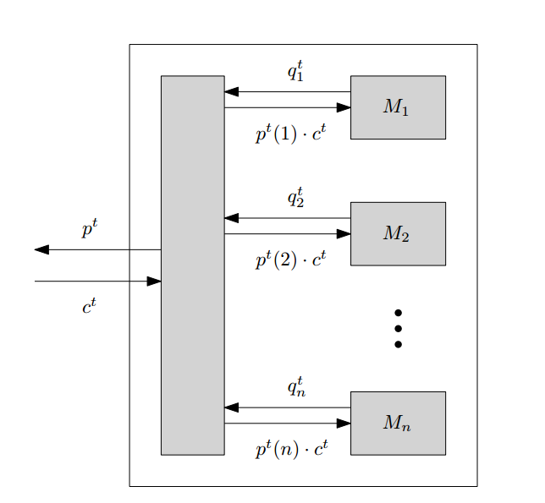
From External to Swap Regret
Theorem (Blum & Mansour 2007):If there is a no-external-regret algorithm for a setting, there is also a no-swap-regret algorithm.
Proof: Polynomial black-box reduction.
$$u^{t}$$
$$u^{t}$$
$$u^{t}$$
$$u^{t}$$

Slide 38
From External to Swap Regret
Proof: Average expected reward of the overall algorithm
$$\frac{1}{T}\sum_{t=1}^{T}{\sum_{i=1}^{n}{p^{t}\left(i\right)}u^{t}(i)}$$
No-regret algorithm $M_{j}$ choses $q_{j}^{1},…,q_{j}^{T}$, gets $p^{1}\left(j\right)u^{1},…,p^{T}\left(j\right)u^{T}$. Thus
$$∀k∈A: \frac{1}{T}\sum_{t=1}^{T}{\sum_{i=1}^{n}{{q_{j}^{t}\left(i\right) (p}^{t}\left(j\right)}u^{t}\left(i\right)})≥\frac{1}{T}\sum_{t=1}^{T}{p^{t}\left(j\right)u^{t}\left(k\right)}−{\overline{r}}_{j}$$
Fix an arbitrary $δ:A→A$ and sum over all $j∈A$:
$$\frac{1}{T}\sum_{t=1}^{T}{\sum_{i=1}^{n}{\sum_{j=1}^{n}{q_{j}^{t}\left(i\right)\left(p^{t}\left(j\right) u^{t}\left(i\right)\right)}}}≥\frac{1}{T}\sum_{t=1}^{T}{\sum_{j=1}^{n}{p^{t}\left(j\right)u^{t}\left(δ\left(j\right)\right)}}−\sum_{j=1}^{n}{{\overline{r}}_{j}}$$

Slide 39
From External to Swap Regret
We are done if we ensure
$$p^{t}\left(i\right)=\sum_{j=1}^{n}{q_{j}^{t}\left(i\right)p^{t}(j)}$$
This is true if $p^{t}$ is the eigenvector of matrix given by $q_{j}^{t}$ for $λ=1.$
Equivalently, $p^{t}$ are the stationary distribution of Markov chain.
Such vector $p^{t}$ always exists and can be easily found!

Slide 40
From External to Swap Regret
Corollary: Let $\overline{r_{M}}\left(t\right)→0$ be the external regret convergence bound for a base algorithm used in the black-box reduction with $\left|A\right|$ actions. Than the swap regret of the overall algorithm is
$$\overline{r_{sw}}\left(T\right)≤\left|A\right|\overline{r_{M}}\left(T\right).$$
Corollary: The black-box reduction with Hedge for all actions produces an algorithm with $\overline{r_{sw}}\left(T\right)≤2\left|A\right|\sqrt{\ln{|A|}/T}$.

Slide 41
No-Regret Dynamics – full information
Definition:
1) Each player $i$ choses independently a mixed strategy $σ_{i}^{t}$ using a no-regret algorithm.
2) Each player receives for all $a_{i}∈A_{i}$ rewards
$$u_{i}^{t}\left(a_{i}\right)=E_{a_{−i}\sim σ_{−i}}[U\left(a_{i},a_{−i}\right)]$$

Slide 42
No-Regret Dynamics – full information
Theorem: If after T iterations of no-regret dynamics each player has external regret lower then $ε$ than $σ=\frac{1}{T}\sum_{t}^{T}{σ^{t}}$, where $σ^{t}=\prod_{i=1}^{k}{σ_{i}^{t}}$, is an $ε$-coarse correlated equilibrium of the game. I.e., for any $a_{i}^{′}∈A_{i}$
$$E_{a\sim σ}\left[U_{i}\left(a\right)\right]≥E_{a\sim σ}\left[U_{i}\left({a_{i}^{′},a}_{−i}\right)\right]−ε$$
Corollary: If we run Hedge in a game with less than $|A|$ actions for each player for $T$ iterations, the resulting average strategy is an ($\sqrt{ln(|A|)/T})$-coarse correlated equilibrium of the game.
Corollary: If we run regret matching+ in a game with less than $|A|$ actions for each player for $T$ iterations, the resulting average strategy is an ($\sqrt{|A|/T})$-coarse correlated equilibrium of the game.

Slide 43
Minimax Theorem
Note: In zero-sum games, coarse correlated equilibria are Nash.
Theorem (Minimax Theorem): For any matrix game $G$
$$\max_{x}{\min_{y}{x^{T}Gy=\min_{y}{\max_{x}{x^{T}Gy}}}}$$
Proof: For contradiction assume that for some $α>0$
$$\max_{x}{\min_{y}{x^{T}Gy<\min_{y}{\max_{x}{x^{T}Gy}−α}}.}$$
Set $ε=\frac{α}{2}$ and let both players run Hedge for time $τ=2\ln{n}/ε^{2}$. Let $\hat{x},\hat{y}$ be the empirical frequencies of their play and $v$ the average reward of the maximizer.
$$\max_{x}\min_{y}{x^{T}Gy}≥\min_{y}{{\hat{x}}^{T}Gy}≥v−ε≥\max_{x}{x^{T}G\hat{y}}−2ε≥\min_{y}{\max_{x}{x^{T}Gy}−α}$$

Slide 44
No-Regret Dynamics
Theorem: If after T iterations of no-regret dynamics each player has swap regret lower then $ε$ than $σ=\frac{1}{T}\sum_{t}^{T}{σ^{t}}$, where $σ^{t}=\prod_{i=1}^{k}{σ_{i}^{t}}$, is an $ε$-correlated equilibrium of the game. I.e., for any player $i$ and switching function $δ:A→A$
$$E_{a\sim σ}\left[U_{i}\left(a\right)\right]≥E_{a\sim σ}\left[U_{i}\left({{δ(a}_{i}^{}),a}_{−i}\right)\right]−ε$$

Slide 45
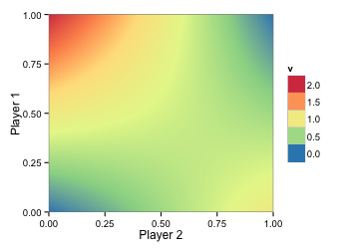
Regret matching+
 |  |  | $$\overline{σ_{2}}$$
 |  |  | R₂ | 0 | 0
 |  |  | r₂
$$\overline{σ_{1}}$$ | R₁ | r₁ | $$σ^{t}$$ | 0.5 | 0.5
 | 0 |  | 0.5 | 2 | 0
 | 0 |  | 0.5 | 0 | 1
Iteration:
0

Slide 46
Regret matching+
 |  |  | $$\overline{σ_{2}}$$
 |  |  | R₂ | 0 | 0
 |  |  | r₂
$$\overline{σ_{1}}$$ | R₁ | r₁ | $$σ^{t}$$ | 0.5 | 0.5
 | 0 | 0.25 | 0.5 | 2 | 0
 | 0 | -0.25 | 0.5 | 0 | 1
Iteration:
1

Slide 47
Regret matching+
 |  |  | $$\overline{σ_{2}}$$
 |  |  | R₂ | 0 | 0
 |  |  | r₂
$$\overline{σ_{1}}$$ | R₁ | r₁ | $$σ^{t}$$ | 0.5 | 0.5
 | 0.25 | 0.25 | 0.5 | 2 | 0
 | 0 | -0.25 | 0.5 | 0 | 1
Iteration:
1

Slide 48
Regret matching+
 |  |  | $$\overline{σ_{2}}$$
 |  |  | R₂ | 0 | 0
 |  |  | r₂
$$\overline{σ_{1}}$$ | R₁ | r₁ | $$σ^{t}$$ | 0.5 | 0.5
1 | 0.25 | 0.25 | 1 | 2 | 0
0 | 0 | -0.25 | 0 | 0 | 1
Iteration:
1

Slide 49
Regret matching+
 |  |  | $$\overline{σ_{2}}$$
 |  |  | R₂ | 0 | 0
 |  |  | r₂ | -1 | 1
$$\overline{σ_{1}}$$ | R₁ | r₁ | $$σ^{t}$$ | 0.5 | 0.5
1 | 0.25 |  | 1 | 2 | 0
0 | 0 |  | 0 | 0 | 1
Iteration:
1

Slide 50
Regret matching+
 |  |  | $$\overline{σ_{2}}$$ | 0 | 1
 |  |  | R₂ | 0 | 1
 |  |  | r₂ | -1 | 1
$$\overline{σ_{1}}$$ | R₁ | r₁ | $$σ^{t}$$ | 0 | 1
1 | 0.25 |  | 1 | 2 | 0
0 | 0 |  | 0 | 0 | 1
Iteration:
1

Slide 51
Regret matching+
 |  |  | $$\overline{σ_{2}}$$ | 0 | 1
 |  |  | R₂ | 0 | 1
 |  |  | r₂
$$\overline{σ_{1}}$$ | R₁ | r₁ | $$σ^{t}$$ | 0 | 1
1 | 0.25 | 0 | 1 | 2 | 0
0 | 0 | 1 | 0 | 0 | 1
Iteration:
2

Slide 52
Regret matching+
 |  |  | $$\overline{σ_{2}}$$ | 0 | 1
 |  |  | R₂ | 0 | 1
 |  |  | r₂
$$\overline{σ_{1}}$$ | R₁ | r₁ | $$σ^{t}$$ | 0 | 1
1 | 0.25 | 0 | 0.2 | 2 | 0
0 | 1 | 1 | 0.8 | 0 | 1
Iteration:
2

Slide 53
Regret matching+
 |  |  | $$\overline{σ_{2}}$$ | 0 | 1
 |  |  | R₂ | 0 | 1
 |  |  | r₂
$$\overline{σ_{1}}$$ | R₁ | r₁ | $$σ^{t}$$ | 0 | 1
0.46 | 0.25 | 0 | 0.2 | 2 | 0
0.54 | 1 | 1 | 0.8 | 0 | 1
Iteration:
2

Slide 54
Regret matching+
 |  |  | $$\overline{σ_{2}}$$ | 0 | 1
 |  |  | R₂ | 0 | 1
 |  |  | r₂ | 0.4 | 0
$$\overline{σ_{1}}$$ | R₁ | r₁ | $$σ^{t}$$ | 0 | 1
0.46 | 0.25 |  | 0.2 | 2 | 0
0.54 | 1 |  | 0.8 | 0 | 1
Iteration:
2

Slide 55
Regret matching+
 |  |  | $$\overline{σ_{2}}$$ | 0 | 1
 |  |  | R₂ | 0.4 | 1
 |  |  | r₂ | 0.4 | 0
$$\overline{σ_{1}}$$ | R₁ | r₁ | $$σ^{t}$$ | 0.29 | 0.71
0.46 | 0.25 |  | 0.2 | 2 | 0
0.54 | 1 |  | 0.8 | 0 | 1
Iteration:
2

Slide 56
Regret matching+
 |  |  | $$\overline{σ_{2}}$$ | 0.19 | 0.81
 |  |  | R₂ | 0.4 | 1
 |  |  | r₂ | 0.4 | 0
$$\overline{σ_{1}}$$ | R₁ | r₁ | $$σ^{t}$$ | 0.29 | 0.71
0.46 | 0.25 |  | 0.2 | 2 | 0
0.54 | 1 |  | 0.8 | 0 | 1
Iteration:
2

Slide 57
Regret matching+
Iteration:
3

Slide 58
Regret matching+
Iteration:
4

Slide 59
Regret matching+
Iteration:
5

Slide 60
Regret matching+
Iteration:
6

Slide 61
Regret matching+
Iteration:
7

Slide 62
Regret matching+
Iteration:
8

Slide 63
Regret matching+
 |  |  | $$\overline{σ_{2}}$$ | 0.30 | 0.70
 |  |  | R₂ | 0.83 | 1.15
 |  |  | r₂
$$\overline{σ_{1}}$$ | R₁ | r₁ | $$σ^{t}$$ | 0.42 | 0.58
0.33 | 0.17 |  | 0.11 | 2 | 0
0.67 | 1.30 |  | 0.88 | 0 | 1
Iteration:
8

Slide 64
Plan
Online learning and prediction
single agent learns to select the best action
Learning in normal form games
the same algorithms used by multiple agents
Learning in extensive form games
generalizing these ideas to sequential games
Brief introduction to neural networks
DeepStack

Slide 65
Algorithms for learning in simple and complex games Refresh
Viliam Lisý
Artificial Intelligence Center
Department of Computer Science, Faculty of Electrical Engineering
Czech Technical University in Prague
(Sep 25, 2018)

Slide 66
Prediction with expert advice
 | $$σ^{0}$$ | $$u^{0}$$ | $$σ^{1}$$ | $$u^{1}$$ | $$σ^{2}$$ | $$u^{2}$$ | … | $$σ^{T}$$ | $$u^{T}$$
$$a_{1}$$ | 0.2 | 0 | 0.1 | 1 | 0.3 | 0
$$a_{2}$$ | 0.5 | 0.5 | 0.4 | 0.5 | 0.3 | 1
$$a_{3}$$ | 0.3 | 1 | 0.5 | 0 | 0.4 | 0
$$σ^{t}⋅u^{t}$$ | $$x^{0}=0.55$$ |  | $$x^{1}=0.3$$ |  | $$x^{2}=0.3$$ |  |  | $$x^{T}$$
Problem definition
Set of $n$ actions (experts) $A=\{a_{1}, a_{2}, …,a_{n}\}$
Set of time steps $t=\left\{1,2,…, T\right\}$
In each step
Decision-maker selects a mixed strategy $σ^{t}$
An adversary selects rewards $u^{t}:A→[0,1]$ (adaptive vs oblivious)
Action $a^{t}∈A$ is selected based on $σ^{t}$
The decision-maker receives reward $u^{t}(a^{t})$ (learns the whole $u^{t})$

Slide 67
Regret Matching+
The algorithm maintains cumulative regrets-like values $Q(i)$ for each action $i∈A$.
Initialize $Q^{1}\left(i\right)=0$ for every $i∈A$
For each time $t=1,2,…, T$
Play $σ^{t}(i)=Q^{t}(i)/\sum_{j∈A}{Q^{t}(j)}$
Given rewards $u^{t}$, for each $i∈A$set
$$Q^{t+1}\left(i\right)=\max{(0,Q^{t}\left(i\right)+r^{t}\left(i\right))}=\max{(0,} u^{t}\left(i\right)−\sum_{j∈A}{σ^{t}\left(j\right)u^{t}(j))}$$

Slide 68
RM+ Regret Bound
Lemma: Regret-like values $Q^{t}\left(i\right)$ are an upper bound on $R^{t}\left(i\right).$
Proof: $Q^{t+1}\left(i\right)−Q^{t}\left(i\right)=\max\left(0,Q^{t}\left(i\right)+r^{t}\left(i\right)\right)−Q^{t}\left(i\right)$
$$≥Q^{t}\left(i\right)+r^{t}\left(i\right)−Q^{t}\left(i\right)=r^{t}(i)$$
Lemma: For any $i$and value functions $Q^{T}\left(i\right)≤\sqrt{nT}$.
Proof: ${\left(\max_{i∈A }{Q^{T}\left(i\right)}\right)}^{2}=\max_{i∈A }{Q^{T}{\left(i\right)}^{2}}≤\sum_{i∈A}{Q^{T}{\left(i\right)}^{2}}=$
$=\sum_{i∈A}{\max{(0,Q^{T−1}\left(i\right)+u^{T}(i)}−\sum_{j∈A}{σ^{T}\left(j\right)u^{T}\left(j\right)})^{2}}$
… $≤\sum_{i}{Q^{T−1}{\left(i\right)}^{2}+n}$
By induction $Q^{T}{\left(i\right)}^{2}≤nT$.

Slide 69
No-Regret Dynamics – full information
Theorem: If after T iterations of no-regret dynamics each player has external regret lower then $ε$ than $σ=\frac{1}{T}\sum_{t}^{T}{σ^{t}}$, where $σ^{t}=\prod_{i=1}^{k}{σ_{i}^{t}}$, is an $ε$-coarse correlated equilibrium of the game ($ε$-Nash equilibrium in zero-sum). I.e., for any $a_{i}^{′}∈A_{i}$
$$E_{a\sim σ}\left[U_{i}\left(a\right)\right]≥E_{a\sim σ}\left[U_{i}\left({a_{i}^{′},a}_{−i}\right)\right]−ε$$
Corollary: If we run regret matching+ in a game with less than $|A|$ actions for each player for $T$ iterations, the resulting average strategy is an ($\sqrt{|A|/T})$-coarse correlated equilibrium of the game.

Slide 70
Algorithms for learning in simple and complex games Learning in Extensive Form Games
Viliam Lisý
Artificial Intelligence Center
Department of Computer Science, Faculty of Electrical Engineering
Czech Technical University in Prague
(Sep 25, 2018)

Slide 71
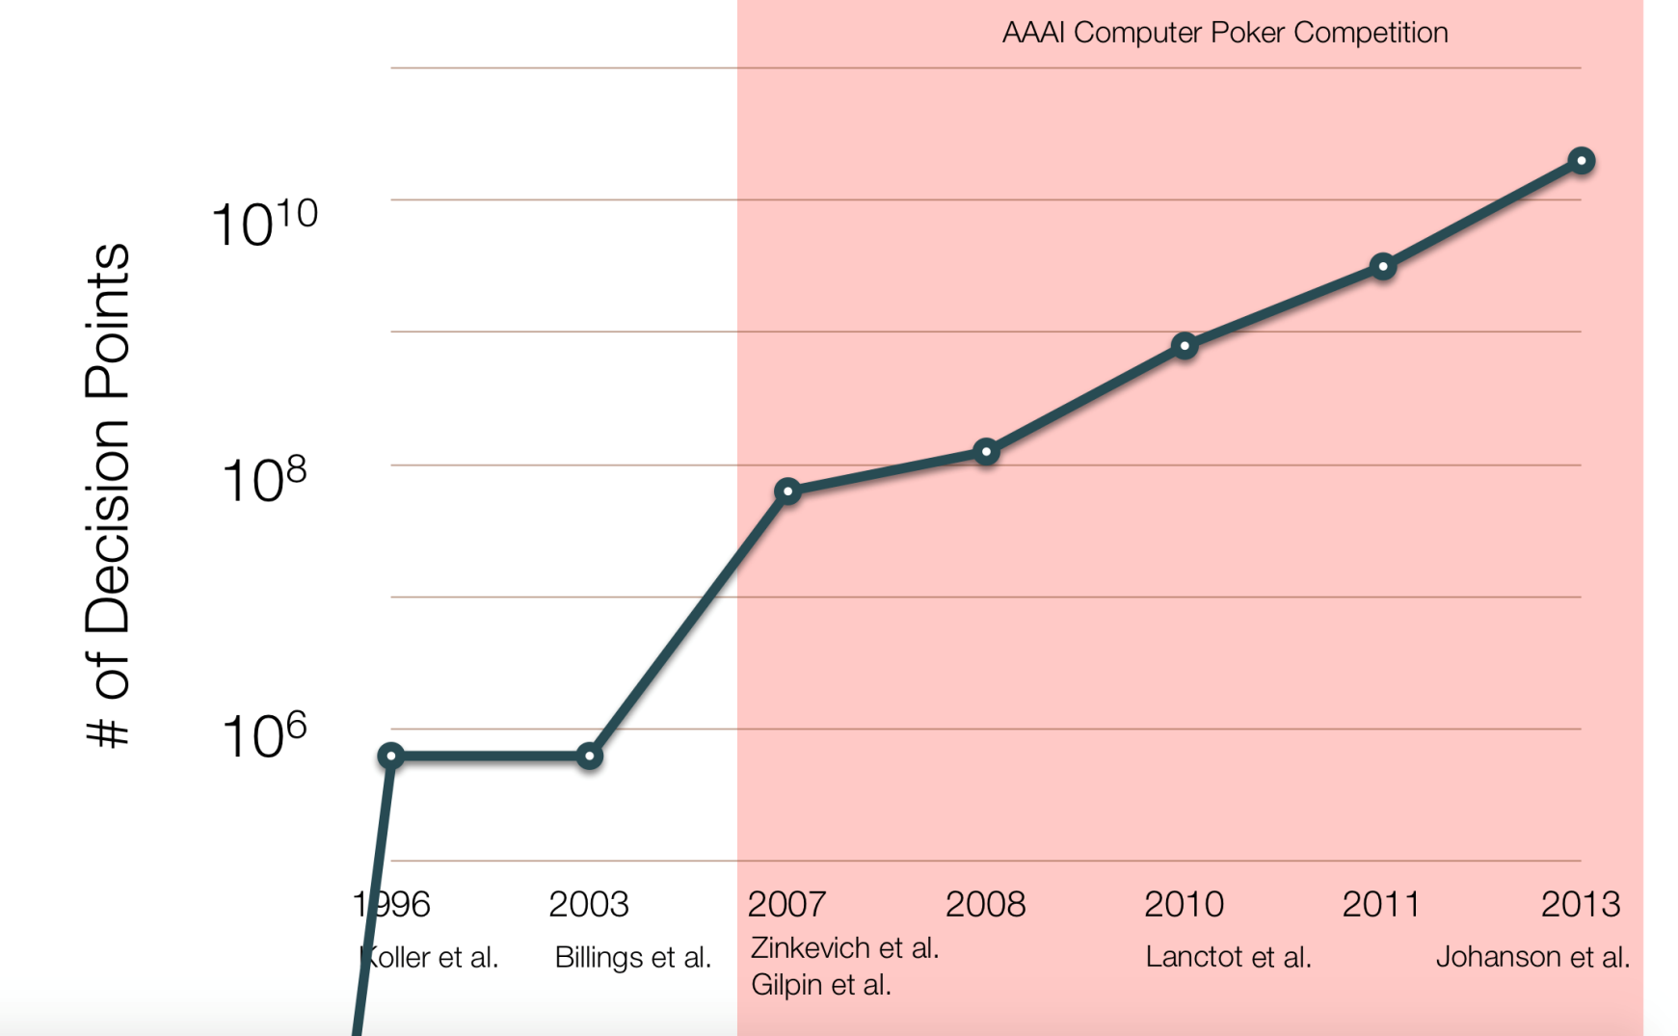
Impact on poker performance
1.4 x 10¹³ Heads-Up Limit Texas Hold’em
LP CFR MCCFR CFR-BR CFR+
2015
Bowling et al.

Slide 72
Extensive form games

Slide 73
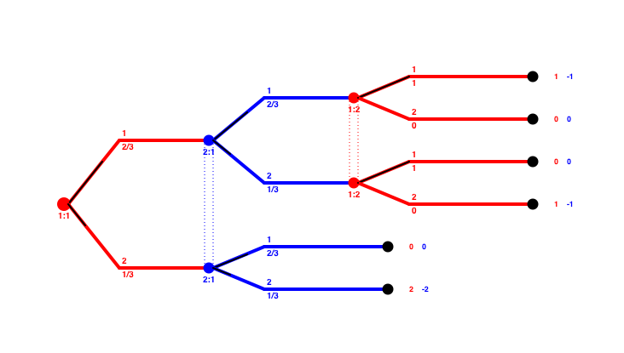
Counterfactual Regret - Motivation
1 -1
0.5 -0.5
1
1
1 | 0
0 | 1
1/2
0 0
0
1/2
0 0
0
1
1/2
1 -1
1
1
0 0
1/2
0 | 2
1/2
2 -2
1 -1
0
1/2
Take the current reach probabilities?
-> undefined belief
Take only opponent’s reach probability!
-> defined where necessary

Slide 74
Counterfactual Regret - Definition
1 -1
0 0
0 0
1 -1
0 0
2 -2
Counterfactual value: $v_{i}^{σ}\left(I,a\right)=\sum_{\left(h,z\right)∈Z_{I}}{π_{−i}^{σ}\left(h\right)}π^{σ}\left(ha,z\right)u_{i}(z)$
Counterfactual regret: ${ r}^{t}\left(I,a\right)=v_{i}^{σ^{t}}\left(I,a\right)−v_{i}^{σ^{t}}\left(I\right)$
Can be computed in one tree walk

Slide 75
Counterfactual Regret Minimization
1) Walk the tree to compute conterfactual values in all ISs
2) Use RM, RM+, Hedge,… to compute next strategy for each IS
3) Goto 1
4) Return mean of all used strategies

Slide 76
Counterfactual regret minimization
Player 1 iteration
0.5
r=-0.11
$$\frac{1}{3}$$
$$0.3$$
$$\frac{1}{3}$$
$$\frac{1}{3}$$
2 -1
0.61
$$0.4$$
0.83
$$\frac{1}{3}$$
r= 0.22
$$\frac{1}{3}$$
$$\frac{1}{3}$$
$$0.3$$
r=-0.11
0.5

Slide 77
Counterfactual regret minimization
Player 2 iteration
r= 0
R: 0.3*0
+ 0.4*-1.17
+ 0.3*0.5
= -0.318
0.5
r= 0.5
$$0.3$$
r=-0.5
$$\frac{1}{3}$$
r= -1.17
$$0.0$$
2 -1
P: 0.3*0.5
+ 0.4*0.33
+ 0.3*-0.5
= 0.132
$$0.4$$
0.17
$$\frac{1}{3}$$
$$0.42$$
r= 0.33
$$\frac{1}{3}$$
r= 0.83
$$0.58$$
S: 0.3*-0.5
+ 0.4*0.83
+ 0.3*0
= 0.182
$$0.3$$
r= 0.5
r=-0.5
0.5
r= 0

Slide 78
Counterfactual regret minimization
Each iteration requires full tree traversal
Average strategy converges
1000 iterations
for a near optimal
strategy

Slide 79
Counterfactual Regret Minimization
Theorem (Zinkevich et al. 2008): For a sequence of (mixed) strategies $σ_{i}^{t}$, let $R_{i,imm }^{T}\left(I\right)=\max_{a}\sum_{t∈1..T}{r^{t}(I,a)}$ then
$$R_{i,full}^{T}≤\sum_{I}{R_{i,imm}^{T,+} (I) }$$
Proof: Let $D(I)$ be the information sets reachable from $I$, $Succ_{i}\left(I,a\right)$ be the possible next information sets, $Succ_{i}\left(I\right)=\bigcup_{a∈A(I)}{Succ_{i}(I,a)}$.
$$R_{i,full }^{T}\left(I\right)=\max_{σ^{′}∈Σ_{i}}{\sum_{t∈1..T}{\left(v_{i}\left(σ^{t}{\left.​\right|}_{D\left(I\right)→σ^{′}},I\right)−v_{i}\left(σ^{t},I\right)\right)}}$$
$v_{i}^{σ}\left(I,a\right)=\sum_{\left(h,z\right)∈Z_{I}}{π_{−i}^{σ}\left(h\right)}π^{σ}\left(ha,z\right)u_{i}\left(z\right);{ r}^{t}\left(I,a\right)=v_{i}^{σ^{t}}\left(I,a\right)−v_{i}^{σ^{t}}\left(I\right)$
$R_{i,imm}^{T} \left(I\right)= \max_{a∈A\left(I\right)}{\sum_{t∈1..T }{\left(v_{i}\left(σ^{t}{\left.​\right|}_{I→a},I\right)−v_{i}\left(σ^{t},I\right)\right)}{}}$

Slide 80
Lemma: $R_{i,full}^{T}\left(I\right)≤R_{i,imm}^{T}\left(I\right)+\sum_{I^{′}∈Succ_{i}(I)}{R_{i,full}^{T,+}(I^{′})}$
$R_{i,full }^{T}\left(I\right)=\max_{a∈A\left(I\right)}{\max_{σ^{′}∈Σ_{i}}{\underset{t∈1..T}{∑}}}$
${(v}_{i}\left(σ^{t}{\left.​\right|}_{I→a},I\right)−v_{i}\left(σ^{t},I\right)$
$+\sum_{I^{′}∈Succ_{i}\left(I,a\right)}{succ_{i}^{σ}\left(I^{′} | I,a\right)(\frac{π_{−i}^{σ^{t}}\left(I\right)}{π_{−i}^{σ^{t}}\left(I^{′}\right)})\left(v_{i}\left(σ^{t}{\left.​\right|}_{D\left(I \right)→σ^{′}},I′ \right)−v_{i}\left(σ^{t},I′ \right)\right)})$
$R_{i,full }^{T}\left(I\right)≤\max_{a∈A\left(I\right)}{\max_{σ^{′}∈Σ_{i}}{\underset{t∈1..T}{∑}}}(v_{i}\left(σ^{t}{\left.​\right|}_{I→a},I\right)−v_{i}\left(σ^{t},I\right)$)
$+\max_{a∈A\left(I\right)}{\max_{σ^{′}∈Σ_{i}}{\underset{t∈1..T}{∑}}}\sum_{I^{′}∈Succ_{i}\left(I,a\right)}{\left(v_{i}\left(σ^{t}{\left.​\right|}_{D\left(I^{′}\right)→σ^{′}},I^{′}\right)−v_{i}\left(σ^{t},I^{′}\right)\right)}$
$R_{i,full }^{T}\left(I\right)≤R_{i,imm}^{T}\left(I\right)+\max_{a∈A\left(I\right)}\underset{I^{′}∈Succ_{i}\left(I,a\right)}{∑}$ $R_{i,full }^{T}\left(I′\right)$
$≤ R_{i,imm}^{T}\left(I\right)+\underset{I^{′}∈Succ_{i}\left(I\right)}{∑}$ $R_{i,full }^{T,+}\left(I′\right)$.
The proof of the theorem is completed by induction, using the Lemma above.

Slide 81
Average Strategy in CFR
$${\overline{σ}}_{i}^{T}\left(I,a\right)=\frac{\sum_{t=1}^{T}{π_{i}^{σ^{t}}\left(I\right)σ^{t}\left(I,a\right)}}{\sum_{t=1}^{T}{π_{i}^{σ^{t}}\left(I\right)}}$$
1
0
1
0
½
½
1
1
1
1
1
1
$$\frac{5}{6}$$
$$\frac{1}{6}$$
$$\frac{5}{6}$$
$$\frac{1}{6}$$
$$\frac{2}{3}$$
$$\frac{1}{3}$$
$$\frac{1}{3}$$
$$\frac{2}{3}$$
$$\frac{3}{5}$$
$$\frac{2}{5}$$
1
Weighted averaging!

Slide 82
CFR+ Convergence Speed
Theorem (Tammelin et al. 2015): The mean strategies form CFR+ in a game with payoff range $Δ$, $A=\max_{I}{|A\left(I\right)|},$ after $T$
iterations form an $\frac{2\left({|I}_{1}|+{|I}_{2}|\right)Δ\sqrt{A}}{\sqrt{T}}$-Nash equilibrium.

Slide 83
CFR Variants – CFR-BR
Opponent always plays best response (Johanson et al. 2012)
No storage for the opponent’s strategy
No need for average strategy
Opponent can play in a finer abstraction
Infinite strategy space
Optimal abstract strategies

Slide 84
CFR Variants – CFR-BR
Theorem (Johanson et al. 2012):
After T iterations, the average strategy of CFR-BR converges to
$\frac{Δ\left|I_{1}\right|\sqrt{{|A}_{1}|}}{\sqrt{T}}$-Nash equilibrium
Proof sketch:
CFR player: $σ_{i}^{0},σ_{i}^{1},…,σ_{i}^{T}$ - no regret sequence of strategies
BR player: ${BR(σ}_{i}^{0}),{BR(σ}_{i}^{1}),…,{BR(σ}_{i}^{T})$
Both players eventually have external regret $<ε$

Slide 85
CFR Variants – CFR-BR
Theorem (Johanson et al. 2012):
After T iteration with probability (1-p) the current strategy of CFR-BR converges to
$\frac{Δ\left|I_{1}\right|\sqrt{{|A}_{1}|}}{p\sqrt{T}}$-Nash equilibrium
Proof sketch:
${\overline{r}}_{i,full}^{T}=\frac{1}{T}\max_{σ^{′}}{\sum_{t=1}^{T}{u_{i}(σ^{′},σ_{−i}^{t})}}−\frac{1}{T}\sum_{t=1}^{T}{u_{i}\left(σ_{i}^{t},σ_{−i}^{t}\right)}<ε$
$\frac{1}{T}\sum_{t=1}^{T}{u_{i}\left(σ_{i}^{t},σ_{−i}^{t}\right)}≥\frac{1}{T}\max_{σ^{′}}{\sum_{t=1}^{T}{u_{i}\left(σ^{′},σ_{−i}^{t}\right)}}−ε≥\max_{σ^{′}}{ u}_{i}\left(σ^{′},{\overline{σ}}_{−i}^{T}\right)−ε$
$≥v_{i}^{∗}−ε$, but $u_{i}\left(σ_{i}^{t},σ_{−i}^{t}\right)≤v_{i}^{∗}$, therefore $u_{i}\left(σ_{i}^{t},σ_{−i}^{t}\right)>$ $v_{i}^{∗}−\frac{ε}{p}$ often.

Slide 86
Solving Limit Texas Hold’em
(Bowling et al., Sience 2015)
Always fold
Polaris
Previous best

Slide 87
Plan
Online learning and prediction
single agent learns to select the best action
Learning in normal form games
the same algorithms used by multiple agents
Learning in extensive form games
generalizing these ideas to sequential games
Brief introduction to neural networks
DeepStack

Slide 88
Algorithms for learning in simple and complex games Brief Introduction to Neural Networks
Viliam Lisý
Artificial Intelligence Center
Department of Computer Science, Faculty of Electrical Engineering
Czech Technical University in Prague
(Sep 25, 2018)

Slide 89
Neuron
$$x_{1}$$
$$x_{2}$$
$$∑w_{i}x_{i}$$
$$y$$
$$z$$
$$φ$$
…
$$x_{n}$$

Slide 90
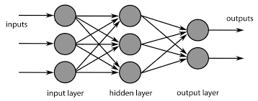
Neural Network
Universal approximation theorem (1989, etc.)
For any non-constant, monotonically increasing, bounded $φ$, a feed-forward network with a single hidden layer containing a finite number of neurons can approximate continuous functions on compact subsets of $R^{n}.$

Slide 91
Gradient Descent
$$a_{n+1}=a_{n}−γ∇f(a_{n})$$
$$f(x)$$
$$a$$
$$b$$
$$=a−(−\frac{1}{3})$$
$$c$$
$$=b−(−\frac{1}{20})$$
$$e$$
$$d$$

Slide 92
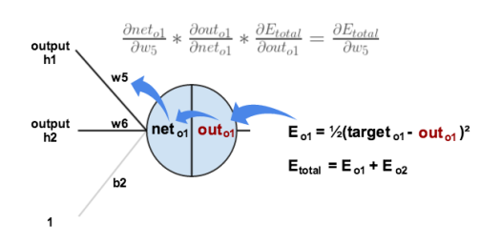
Backpropagation
What is $\frac{δError}{δw_{i}}$ ?
$$x_{1}$$
$$x_{2}$$
$$∑w_{i}x_{i}$$
$$y$$
$$z$$
$$φ$$
…
Error = ${\left(y−y_{g}\right)}^{2}$
$$x_{n}$$
$$\frac{δError}{δw_{2}}=\frac{δError}{δy}∗\frac{δy}{δz}∗\frac{δz}{δw_{2}}$$

Slide 93
Stochastic gradient descent
$$a_{n+1}=a_{n}−γ∇f(a_{n})$$
$$f\left(x\right)=\frac{1}{n}\sum_{i}{f(i,x)}$$
$$a_{k+1}=a_{k}−\frac{γ}{n}\sum_{i}{∇f({i,a}_{k})}$$
An unbiased estimate of the gradient is enough!
In practice, usually mini-batch and not a single sample.

Slide 94
Algorithms for learning in simple and complex games DeepStack
Viliam Lisý
Artificial Intelligence Center
Department of Computer Science, Faculty of Electrical Engineering
Czech Technical University in Prague
(Sep 25, 2018)

Slide 95
Counterfactual regret minimization
Each iteration requires full tree traversal
Average strategy converges
1000 iterations
for a near optimal
strategy

Slide 96
Computing strategies via abstraction
50
Abstraction
1 TB
$$={10}^{12}$$
0
$${10}^{160}$$
Computing
solution (CFR, LP)
“Solution” in the
original game
Translation
Approximate
equilibrium
$${10}^{148}:1$$

Slide 97
Depth limited look-ahead search
Beginning
$$h:S→R$$
Possible ends

Slide 98
Depth limited look-ahead search
Beginning
$$h:S→R$$
Possible ends

Slide 99
Depth limited look-ahead search
Beginning
$$h:S→R$$
Chess
${10}^{47}$ decision points
year 1997
Possible ends

Slide 100
Depth limited look-ahead search
Beginning
K
K
50
100
J
J
$$h:S→R$$
$$h:Δ(S)→R^{n}$$
$$h:R^{2652}→R^{2652}$$
Possible ends

Slide 101
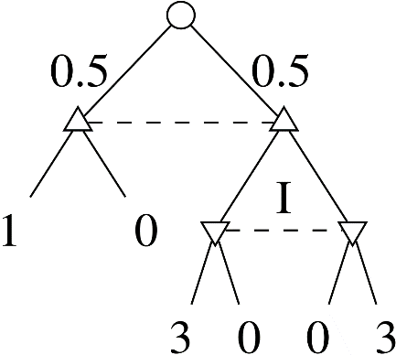
Game decomposition
Perfect information example
Imperfect information example
$$\frac{1}{3}$$
$$\frac{2}{3}$$
$$\frac{1}{3}$$
$$\frac{2}{3}$$

Slide 102
DeepStack team at University of Alberta
Photo: John Ulan for the University of Alberta

Slide 103
CFR-D
CFR with Decomposition (Burch et al. 2014)
Trades-of space for computation
Store only the trunk
Resolve subgames in each iteration
Resolve on demand in play
Trunk
Subgame
…

Slide 104
CDR-D
Augmented information set
Set on undistinguishable histories for any player, not just the deciding one
Subgame (denoted S)
forest of trees closed under descendance and belonging into augmented information sets
R(S)
set of augmented information sets in the root of a subgame

Slide 105
CFR-D: Solving Trunk Strategy
Initialize regrets to 0
For iteration $t=1,…,T$
compute $σ_{↑}^{t}$ from stored regrets
update trunk average strategy by $σ_{↑}^{t}$
For each subgame S
$σ_{S}^{t}←$SOLVE(S, $σ_{↑}^{t}$)
For each augmented $I_{p}∈R\left(S\right)$
Compute value $v_{I_{p}}$
Update average value $cfv_{I_{p}}$
Update trunk regrets using $v_{I_{p}}$
Trunk
Subgame
…

Slide 106
CFR-D: Computing Trunk Strategy

Slide 110
CFR-D: Resolving Subgame
Assume blue player played D and the game reached S1
Unsafe resolving Save resolving
No incentive to change trunk!

Slide 111
CFR-D More Complicated Resolving

Slide 112
CFR-D Resolving Game
When resolving for player 1
Create new chance node as the root
Create new nodes for player 2 grouped by her “information sets”
Connect the root to nodes in proportion to player 1 trunk strategy
For each player 2 node, add follow action leading to subgame
For each player 2 node, add terminate action with CFV of IS
We need
Distribution in the root IS generated by player 1 trunk strategy
Counterfactual value achievable by player 2 in his root ISs

Slide 113
CFR-D Convergence properties
CFR-D achieves no regret in the trunk
It the counterfactual regret at each information set I at the root of a subgame is bounded by $ε_{S}$, then than the average regret over the whole game is
$$R_{full}^{T}≤\frac{N_{TR}\sqrt{A}}{\sqrt{T}}+N_{S}ε_{S}$$
Proof sketch: $σ^{0}[S←σ_{S}^{0.∗}]$, $σ^{1}[S←σ_{S}^{1.∗}]$, …
CF regret in the trunk minimized by CFR
CF regret in the subgame close to 0 for both players
CFR-D resolving forms a Nash equilibrium
If we run the recovery game for each player and each subgame until we reach regret below $ε_{R}$, the combined strategy has regret
$$R_{full}^{T}≤\frac{N_{TR}\sqrt{A}}{\sqrt{T}}+N_{S}(3ε_{S}+2ε_{R})$$

Slide 114
Public Tree

Slide 115
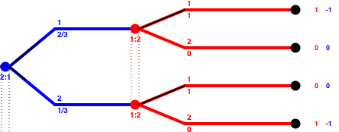
Public Tree
Matching pennies
Phantom Tic-Tac-Toe
Visibility-based pursuit-evasion games

Slide 116
Augmented IS in poker public node

Slide 117
Resolving poker subgame
To resolve, we need
$∀I_{1}∈R\left(S\right) π_{1}\left(I_{1}\right)$
$∀I_{2}∈R\left(S\right) {cfv}_{2}\left(I_{2}\right)$
In poker it means
$π_{1}\left(I_{1}\right)$ - probability that player 1 holds each hand = range
${cfv}_{2}\left(I_{2}\right)$ - how much player 2 can win with each hand
In root (after chance reals hole cards)
$π_{i}\left(I_{i}\right)$ - uniform
${cfv}_{i}\left(I_{i}\right)$ - pre-computed offline

Slide 118
DeepStack: updating maintained values
Assuming DeepStack is player 1
Own action
replace player 2’s cfvs by the once computed in the resolve game
update player 1’s range based on the played strategy
Chance action
replace player 2’s cfvs from the last resolve above chance
keep player 1’s range unchanged
Opponent’s action
no update required!

Slide 119
Depth limited look-ahead search
Beginning
$$h:Δ(S)→R^{n}$$
Possible ends

Slide 120
Depth limited look-ahead search
Beginning
Where do these CFVs come from?
Range
CFVs
$$h:Δ(S)→R^{n}$$
Possible ends

Slide 121
DeepStack: Neural Network

Slide 122
Where do we get training data?
Beginning
Turn
10 M
$$h_{1}:Δ(S)→R^{n}$$
Possible ends

Slide 123
Where do we get training data?
Beginning
Flop
1 M
$$h_{2}:Δ(S)→R^{n}$$
Turn
10 M
$$h_{1}:Δ(S)→R^{n}$$
Possible ends

Slide 124
Where do we get training data?
Beginning
10 M
Flop
1 M
$$h_{2}:Δ(S)→R^{n}$$
Range
CFVs
Turn
10 M
$$h_{1}:Δ(S)→R^{n}$$
Possible ends

Slide 125
DeepStack: Training
Turn Network (right after dealing turn card)
10M pseudo-random ranges, pots, random boards
Solve by $CFR^{+}$ until the end of the game
Extract CFVs for training, train Turn NN
Flop Network (right after dealing flop cards)
10M pseudo-random ranges, pots, random boards
Solve by DeepStack (CFR-D) using the pre-trained Turn NN
Extract CFVs for training, train Turn NN
Pre-flop Network
10M pseudo-random ranges, pots
Enumerating 22100 possible flops and averaging

Slide 126
DeepStack: Convergence
Theorem: If the error of CFVs returned by the value function is less then $ε$ and T iterations of resolving are used for each decision, than the exploitability of the player strategy is less than
$$k_{1}ε+\frac{k_{2}}{\sqrt{T}}$$
where $k_{1},k_{2}$ are game-specific constants.

Slide 127
DeepStack: Results

Slide 128
References
Burch, N., & Bowling, M. (2013). CFR-D: Solving Imperfect Information Games Using Decomposition. arXiv Preprint arXiv:1303.4441, 1–15. Retrieved from http://arxiv.org/abs/1303.4441
Moravčík, M., Schmid, M., Burch, N., Lisý, V., Morrill, D., Bard, N., Davis T., Waugh K., Johanson M., Bowling, M. (2017). DeepStack: Expert-Level Artificial Intelligence in No-Limit Poker. www.deepstack.ai

Slide 129
References
Asu Ozdaglar. 6.254 : Game Theory with Engineering Applications. Lecture 11: Learning in Games. March 11, 2010.
Brandt, Felix, Felix Fischer, and Paul Harrenstein. "On the rate of convergence of fictitious play." International Symposium on Algorithmic Game Theory. Springer Berlin Heidelberg, 2010.
T. Roughgarden, “Lecture Notes: Algorithmic Game Theory,” tech. rep., Stanford, 2013.

Slide 130
References
Blum, Avrim, and Yishay Mansour. "From external to internal regret." Journal of Machine Learning Research 8.Jun (2007): 1307-1324.
T. Roughgarden, “Lecture Notes: Algorithmic Game Theory,” tech. rep., Stanford, 2013.
Tammelin, Oskari, Neil Burch, Michael Johanson, and Michael Bowling. "Solving Heads-Up Limit Texas Hold'em." In Twenty-Fourth International Joint Conference on Artificial Intelligence. 2015.
Bubeck, Sébastien, and Nicolo Cesa-Bianchi. "Regret analysis of stochastic and nonstochastic multi-armed bandit problems." Foundations and Trends in Machine Learning 5.1 (2012): 1-122.

